Slide 1
I/O Clocks User Interfaces

Slide 2
Review
Memory-Mapped I/O
Map all the control registers into the memory space
Each control register is assigned a particular and unique memory address
DMA
A memory address register
A byte count register
One or more control registers
3 modes: Word-at-a-time, Block, Fly-by
Precise vs. Imprecise Interrupt
Precise: Leave the machine in a well-defined state
PC is saved in a known place
All instructions before the one pointed to by the PC have fully executed
No instruction beyond the one pointed to by the PC has been executed
Execution state of the instruction pointed to by the PC is known
Imprecise: Does not meet all requirements as precise

Slide 3
Review
I/O Software
Goals
Device Independent, Error handling, Synchronous vs. Asynchronous, Buffering, Dedicated device allocation
I/O with DMA
Layers
User level I/O software: pooling with daemon scheduling (Asynchronous)
Device independent
Uniform naming, Uniform interface, Independent block size
Buffering
Error handling, Dedicated device allocation
Device Drivers: help OS control specified devices depending on standard interface
Interrupt Handlers: handle interrupt to determine what the system should do

Slide 4
Review
Disk arm scheduling
Seek time
FCFS: Process request sequentially
SSF: the least movement of the disk arm from its current head position
Elevator
Approach: Arm moves in one direction only, satisfying all outstanding requests until it reaches the last track in that direction
Implementation: When the highest numbered cylinder with a pending request has been services, the arm goes to lowest number cylinder with a pending request and then continues moving in an upward direction
Rotational delay
If two or more requests for the same cylinder are pending, the driver can issue a request for the sector that will pass under the head next
The OS should maintain a pending request table for each drive, a seek should be issued to move its arm to the cylinder where it will be needed next
Actual data transfer time (SATA)

Slide 5
Review
Disk arm scheduling
Error handling
Bad sector
Sectors do not correctly read back the value just written to them
Controllers remap the bad sector to the spare and/or Shift all the sectors up one
OS must first acquire a list of bad sectors, then it can build remapping tables
Seek errors
Move the arm as far out as it will go and reset the controller’s internal idea of the current cylinder to 0

Slide 6
Review
Disk arm scheduling
Disk Consistency
Stable write: Write block on drive 1, then reading it back to verify. The driver 2 is written and reread until it succeeds
Stable read: First read block on drive 1 in n times. If all of these give bad ECCs, reading on drive 2
Crash recovery: scans both disks comparing corresponding blocks. Bad block is overwritten with the good blocks or block from driver 1 is written onto drive 2
Optimizing: using Nonvolatile/ Volatile RAM to replace in using driver 2

Slide 7
Objectives
Clocks
Clock Hardware
Clock Software
Soft Timers
User Interfaces
Input Software
Output Software

Slide 8
Clocks
Overview
Is also call timers
Are essential to the operation of any multi-programmed system
Maintain the time of day and prevent one process from monopolizing the CPU, among other things
The clock software take the form of a device driver, even though a clock is neither a block device nor a character device

Slide 9
Clocks
Clock Hardware
Structure
The simpler clocks are tied to the 110-120 volt power line and cause an interrupt on every voltage cycle at 50-60Hz
Is built out of three components: a crystal oscillator, a counter, and a holding register
When a piece of quartz crystal is properly cut and mounted under tension, it can be made to generate a periodic signal of very great accuracy, typically in the range of several hundreds MHz
Using electronics, this base signal can be multiplied by a small integer to get frequencies up to 1000MHz or even more
At least one such circuit is usually found in any computer, providing a synchronizing signal to the computer’s various circuits.
This signal is fed into the counter to make it count down to zero. When the counter gets to zero, it causes a CPU interrupt

Slide 10
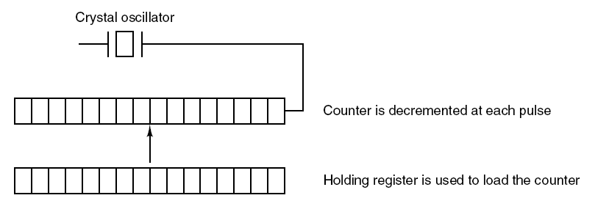
Clocks
Clock Hardware
Tanenbaum, Fig. 5-32.

Slide 11
Clocks
Clock Hardware
Programmable clocks typically have several modes of operation
One-shot mode
When the clock is started, it copies the value of the holding register into the counter and then decrements the counter at each pulse from the crystal
When the counter gets to zero, it cause an interrupt and stops until it is explicitly started again by the software
Square-wave mode
After getting to zero and causing the interrupt, the holding register is automatically copied into the counter, and the whole process is repeated again indefinitely
These periodic interrupts are called clock ticks
Advantages
Its interrupt frequency can be controlled by software
If a 500MHz crystal is used, then the counter is pulse every 2nsec. With unsigned 32 bit registers, interrupts can be programmed to occur at intervals from 2 – 8.6 nsec
Contain two or three independently programmable clocks

Slide 12
Clock
Clock Software
All the clock hardware does is generate interrupts at known intervals
Everything else involving time must be done by the software, the clock driver
Typical duties of a clock driver
Maintaining the time of day (real time).
Just requires incrementing a counter at each clock ticks
Problem: With a clock rate of 60Hz, a 32 bit counter will overflow in just over 2 years → the system cannot store the real time as the number of tick since 1th, Jan, 1970
Solution
First Approach: using 64 bit count → maintaining the counter more expensive since it has to be done many time in seconds
Second Approach: maintain the time of days in seconds, rather than in tick, using a subsidiary counter to count ticks until a whole second has accumulated → 136 years (2³² seconds)
Third Approach: count in ticks, but to do that relative to the time the system was booted, rather than relative to a fixed external moment. In the system boot time, the current time of day value and store in memory. Later, when the time of day is requested, the stored time of day is added to the counter to get the current time of day

Slide 13
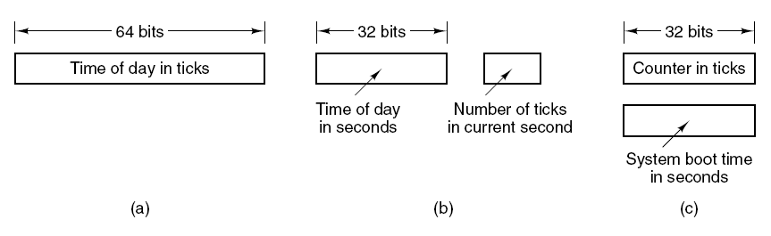
Clocks
Clock Hardware
Tanenbaum, Fig. 5-33.

Slide 14
Clock
Clock Software
Typical duties of a clock driver (cont)
Preventing processes from running longer than they are allowed to.
When a process is started, the scheduler initializes a counter to the value of that process’ quantum in clock ticks
At every clock interrupt, the clock driver decrements the quantum counter by 1.
When it gets the zero, the clock driver call the scheduler to set up another process
Accounting for CPU usage.
First Approach: Using a second timer (distinct with system timer) to calculate how long the process has run from the process is started to be stopped
Second Approach (too expensive and rarely done)
A less accurate, but simpler, way to do accounting is to maintain a pointer to the process table entry for currently running process in a global variable. At every clock tick, a field in the current process’ entry is incremented
Problem: if many interrupts occur during a process’ run, it is still charged for a full tick, even though it did not get much work done

Slide 15
Clock
Clock Software
Typical duties of a clock driver (cont)
Handling alarm system call made by user processes.
A process can request that the OS give it warning after a certain interval, using a signal, interrupt, message, etc … (e.g acknowledged signal)
To implement, a table is used to kept the pending timers. A table is maintained as well as variable giving the time of the next times. Whenever the time of day is updated, the driver checks to see if the closest signal has occurred. If it has, the table searched for the next timer to occur
Providing watchdog timers for parts of the system itself.
OS also need to set timer to cause an interrupt after a sufficiently long time interval
Doing profiling, monitoring, statistics gathering
Os provides a mechanism by which a user program can have the system build up a histogram of its program counter, so it can see where it is spends its time
When profiling is a possibility, at every stick the driver can checks to see if the current process is being profiled, and if so, the bin number corresponding to the current PC. It then increments that bin by one

Slide 16
Clock
Soft Timers
Avoid interrupts
An OS facility that allows efficient scheduling of software events at microsecond granularity
Whenever the kernel is running for some other reason, just before it return to user mode it checks the real time clock to see if a soft timer has expired
If the timer is expired, the scheduled event is performed, with no need to switch into kernel mode since the system is already there
As in the case when the system is already context-switched to the kernel… why not see if other work can be done “while you’re in there?”
After performed, the soft timers is reset to go off again
All that has to be done is copy the current clock value to the timer and add the timeout interval to it
Soft timers stand or fall with the rate at which kernel entries are made for other reasons
System calls
TLB misses
Page faults
I/O interrupts
The CPU going idle

Slide 17
User Interfaces
Input Software
Keyboard Software
Scan code: The number in the I/O port represented 7 bits (8th bit is used to represent key press – 0 or release – 1)
When any key struck, the scan code is put in an I/O register. It is up the driver to determine whether it is lower case, upper case, or the combination.
Although key board interfaces puts the full burden on the software, it is extremely flexible
Two possible philosophies can be adopted for the driver
Raw mode/ character oriented/ noncanonical mode: the driver is just to accept input and pass it upward unmodified
Cooked mode/ line oriented/ canonical mode: the driver handles all the intraline editing, and just delivers corrected lines to the user programs

Slide 18
User Interfaces
Input Software
Keyboard software
Echoing
Many users have grown accustomed to seeing the characters they have just typed appear on the screen
Is complicated because at the very least, the keyboard driver has to figure out where to put the new input without it being overwritten by program output
Get complicated when more than 80 characters have to be displayed in a window with 80 character lines (wrapping around or throwing away)
Tab handling
The driver compute where the cursor is currently located, taking into account both output from programs and output from echoing,
And compute the proper number of spaces to be echoed

Slide 19
User Interfaces Input Software
Keyboard Software
Device equivalence
Logically, at the end of a line of text, one wants a carriage return, to move the cursor back to column 1, and a linefeed, to advance to the next line
If standard form is just to store a linefeed, then carriage returns should be turned into linefeeds (UNIX)
If the internal format is store both, then driver should generate a linefeed when it gets a carriage return and a carriage return when it gets a linefeed
No matter what the internal convention, the monitor may require both a linefeed and a carriage return to be echoed in order to get the screen updated properly

Slide 20
User Interfaces
Mouse Software
Whenever a mouse has moved a certain minimum distance in either direction or a button is depressed or released, a message is sent to the computer (picking up and put down is not)
The message usually occupies 3 bytes containing 3 items
Δx: the change in x position since the last message
Δy: the change in y position since the last message
Buttons: the status of button
Mickey is the unit representing minimum distance about 0.1mm
Most mice report back a maximum of 40 times/sec
Mouse only indicates changes in position, not absolute position itself
The single or double click is distinguished by the software setting

Slide 21
User Interfaces Output Software
Text Windows
The program sends characters to the characters to current windows and they are display there. Usually, a block a character is written in one system call
Screen editors and many other sophisticated programs need to be able to update the screen in complex ways such as replacing one line in the middle of the screen (driver must support escape sequences to move the cursor, insert and delete character …)
Termcap (Berkeley UNIX) defines a number of basic actions that uses a generic escape sequence, the converted to the actual escape sequences
How might the escape sequences be used by a text editor?
After the user types command, the editor might send the escape sequence over the serial line to the terminal
The execution is done

Slide 22
User Interfaces Output Software
The X Window System
The user interface is used all UNIX System
Is very portable and run entirely in user space
Was intended for connecting a large number of remote user terminals with a central compute server, so it is logically split into client and host software
Is not a complete GUI (must be more supported)
X server (local PC, just does what the X Client told)
The software collects input from keyboard and mouse and writes output to the screen
Inside the user’s computer
Displaying bits on the screen
X clients (remote machine)
Running programs
Tells the server to do things, like display text or geometric figures

Slide 23
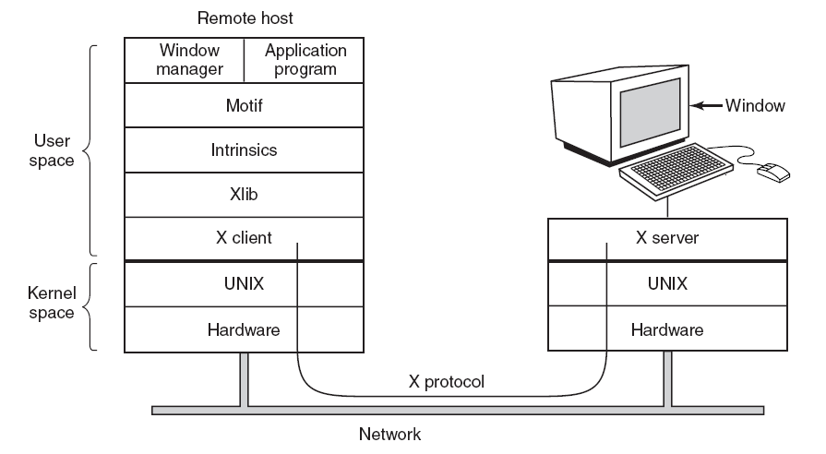
User Interfaces
Output Software
Tanenbaum, Fig. 5-537

Slide 24
User Interfaces Output Software
Graphic Users Interface – GUI
Has four essential elements WIMP (Windows, Icons, Menus, and Pointing device)
The GUI software can be implemented in either user-level code (UNIX) or in the OS itself (Windows)
Windows programs are message oriented
Output almost always goes to a special hardware – graphics adapter
Containing video RAM that holds the image appear on the screen
Support some number of screen sizes
Window
The basic item on the screen is a rectangular area (that can be resized, scrolled)
Its position and size are uniquely determined by giving the coordinates (in pixel) of two diagonally opposite corners
Its coordinate system puts the origin in the upper left-hand corner and has y increase downward

Slide 25
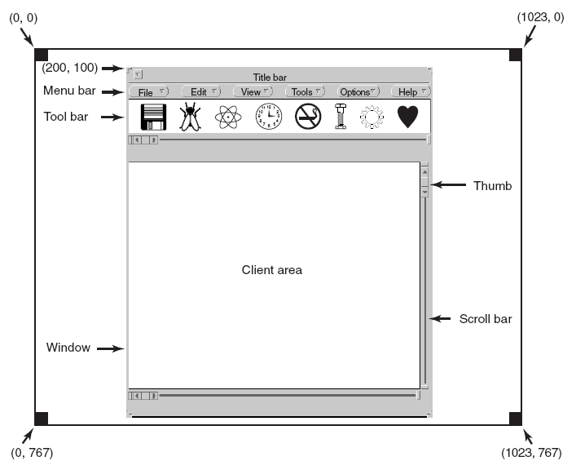
User Interfaces Output Software
Tanenbaum, Fig. 5-39.

Slide 26
User Interfaces Output Software
Bitmaps
The average red, green, and blue values of each grid square are then sampled and saved as the value of one pixel
Use for text
Represent a particular character in some font is as a small bitmap
Adding text to the screen then becomes a matter of moving bitmaps
Problems
They do not scale
Copying between devices with different color properties or between monochrome and color does not work well
Solutions
Windows supports a DIB (Device Independent Bitmap) data structure on file .bmp. Those files have file and information headers and color table before the pixels → the information make easier to move bitmaps between dissimilar devices

Slide 27
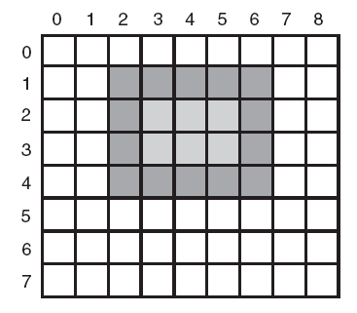
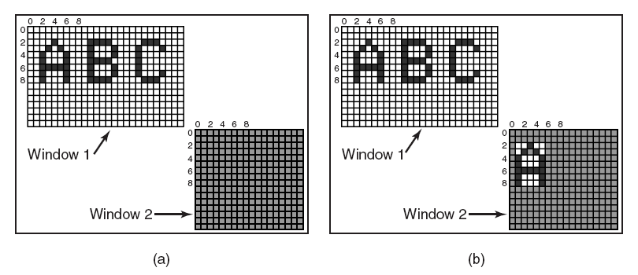
User Interfaces Output Software
Tanenbaum, Fig. 5-41 & 5-42.

Slide 28
User Interfaces Output Software
Fonts
Characters were represented as bitmaps and copied onto the screen or printer
Problems
We just saw, is that a bitmap that makes sense on the screen is too small for the printer
A different bitmap is needed for each character in each size
Solutions
TrueType fonts is introduction which are not bitmaps but outlines the character
Each TrueType character is defined by a sequence of points around its perimeter. All the points are relative to the (0, 0) origin
It is easy to scale the characters up or down with any point size (even fraction)
All that has to be done is to multiply each coordinate by the same scale factor

Slide 29
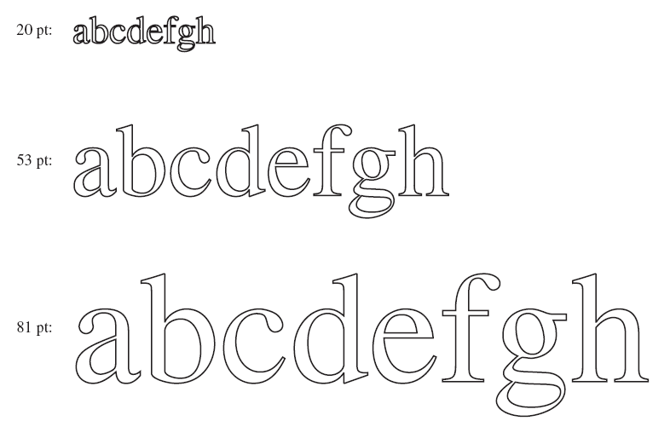
User Interfaces Output Software
Tanenbaum, Fig. 5-12.

Slide 30
Summary
Clocks
User Interfaces
Q&A

Slide 31
Next Lecture
Thin Clients
Power Management

